Slide 1
STUDENT INFORMATION SYSTEM
WITH ASSIGNMENT MANAGEMENT SYSTEM

Slide 2
STUDENT INFORMATION SYSTEM
Student Information System is a management platform which is use to manage student record and make it easy to access.
As we know that it is difficult to maintain records of student manually and it is also a time consuming task.
Student Information System reduces the effort to maintain the record and make it quickly accessible.
Moreover there is a many application which uses the information gathered by SIS .
One of the application which uses the SIS data is Assignment Management System .

Slide 3
Assignment Management system
This module is designed for faculty user and it is a offline platform.
In this module a faculty member uses the University RollNo. of student in order to enter record into submission Table.
Sub modules of assignment management system will be explained later in slides.

Slide 4
STUDENT INFORMATION SYSTEM
Type of users:
Admin
Office
Faculty
First we start with Admin login .

Slide 5
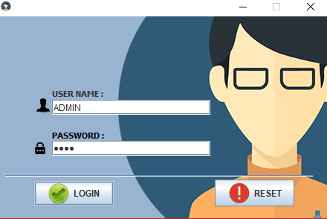
ADMIN Login page

Slide 6
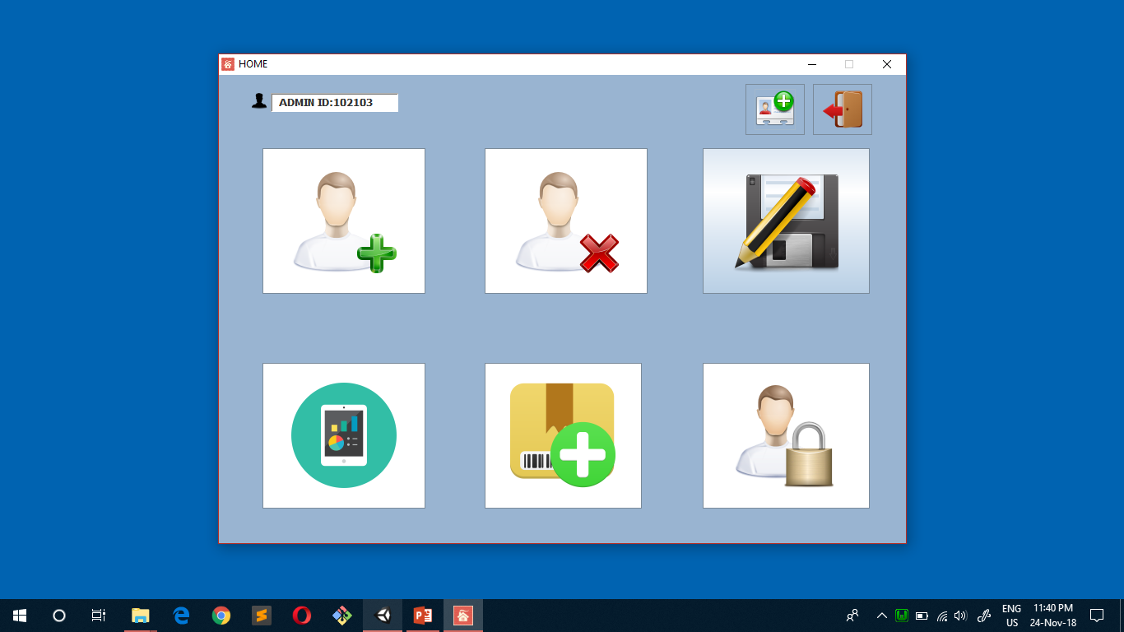
DASHBOARD

Slide 7
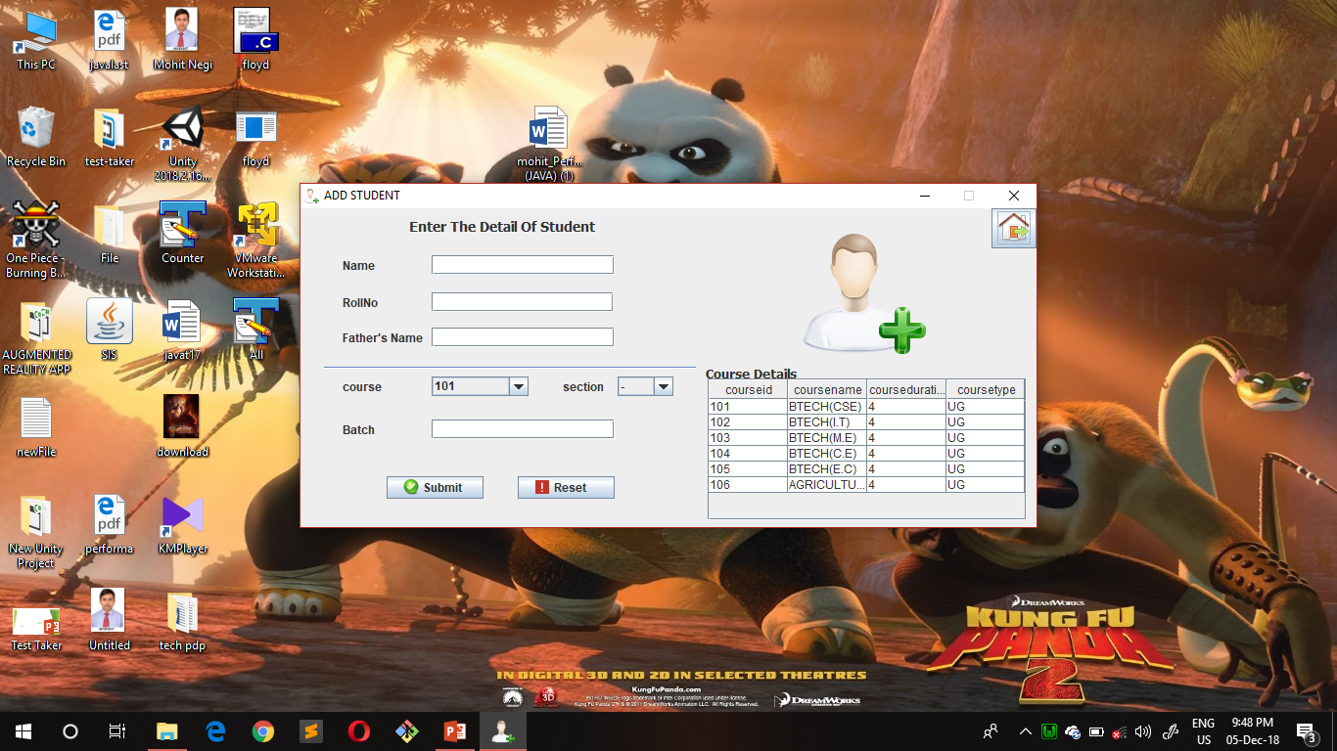
ADD STUDENT RECORD

Slide 8
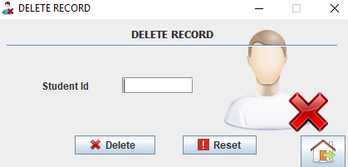
DELETE STUDENT RECORD

Slide 9
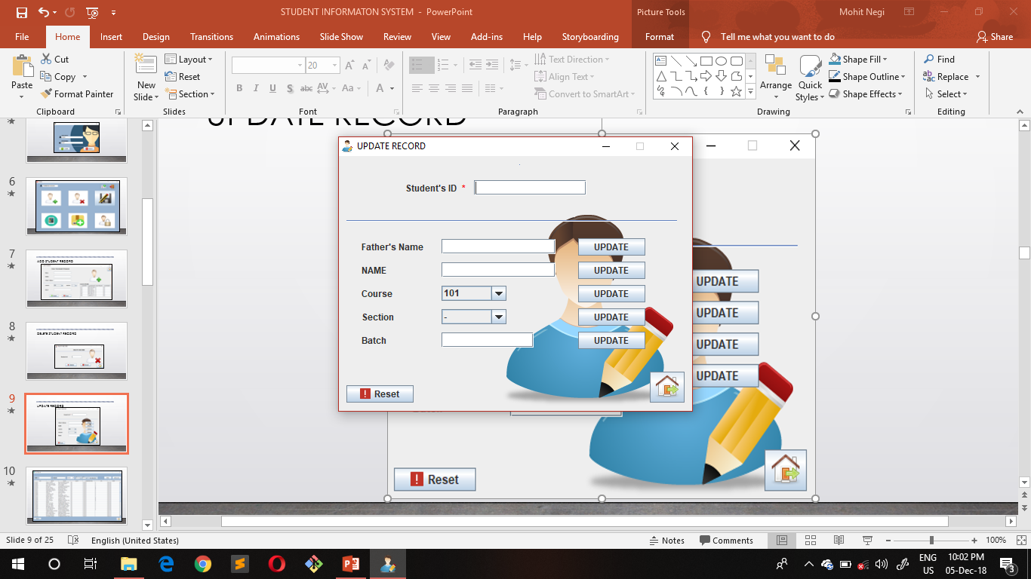
UPDATE RECORD

Slide 10
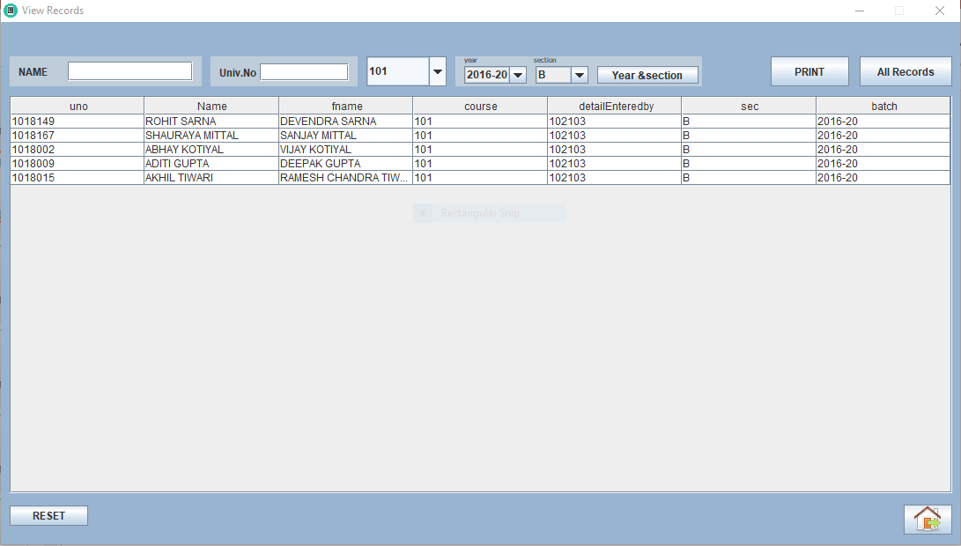
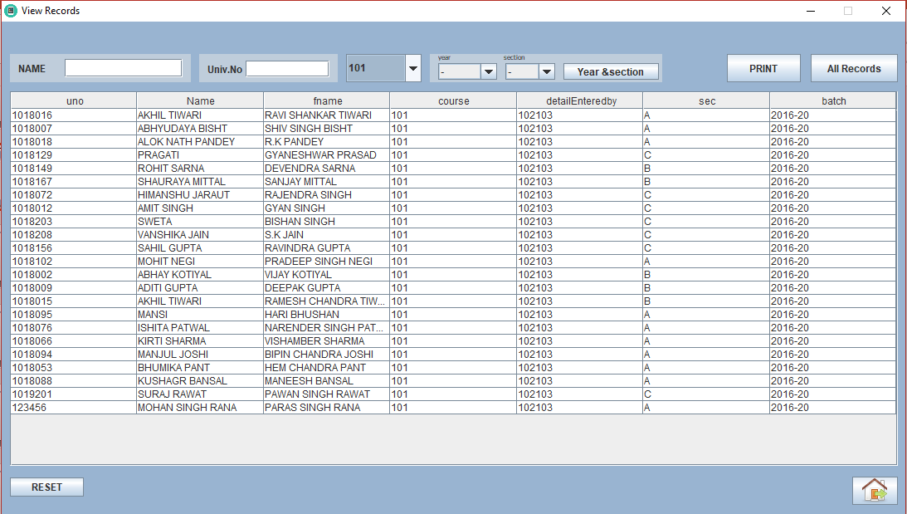
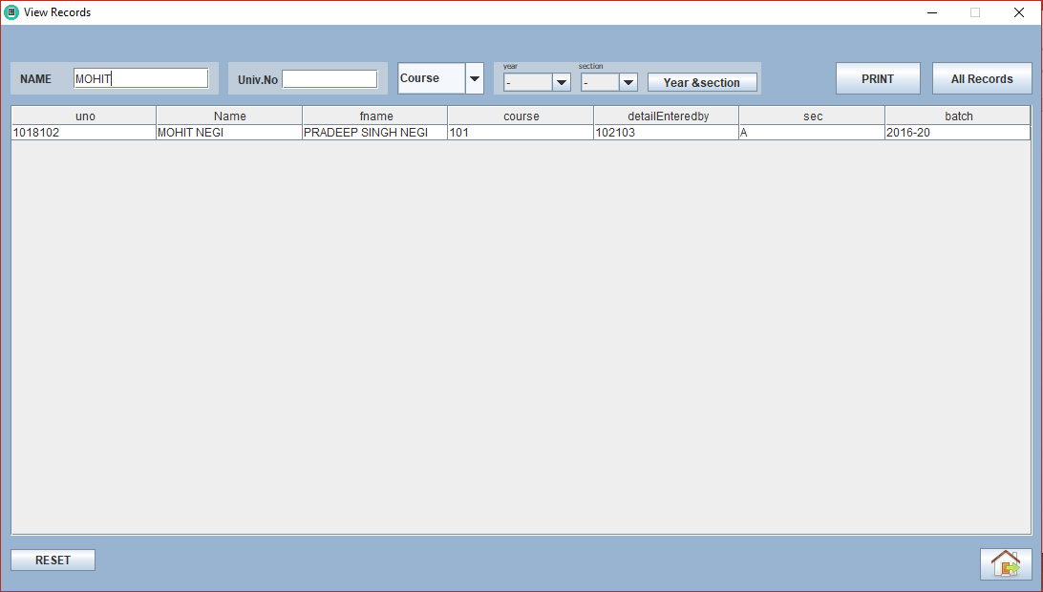
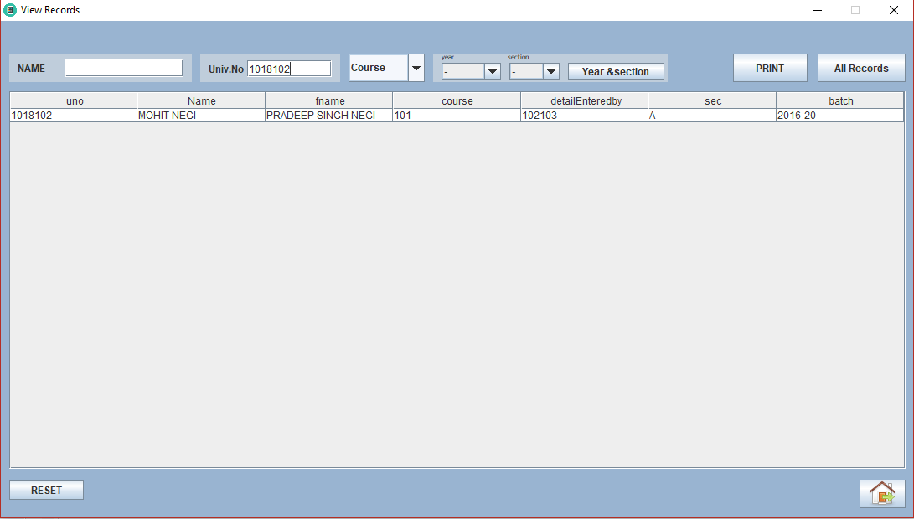
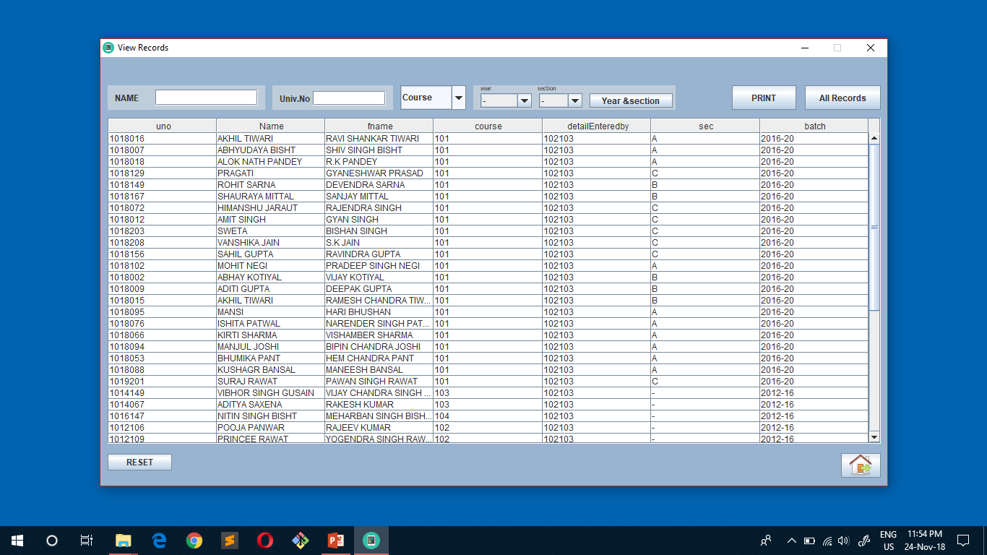
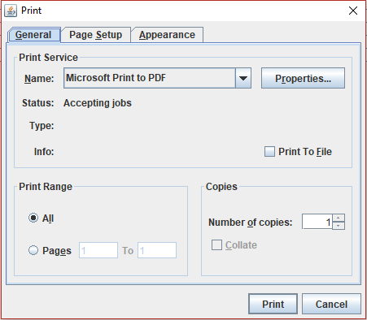
VIEW RECORDS

Slide 11
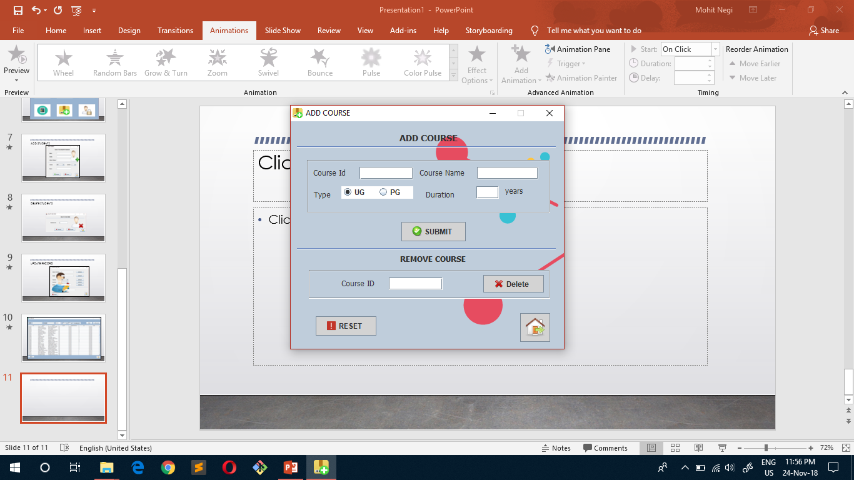
ADD COURSE

Slide 12
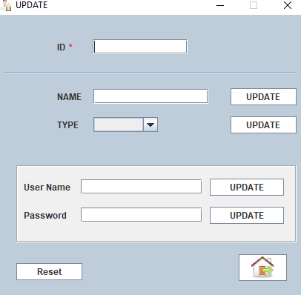
CHANGE PASSWORD

Slide 13
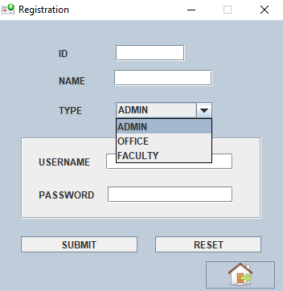
REGISTRATION

Slide 14
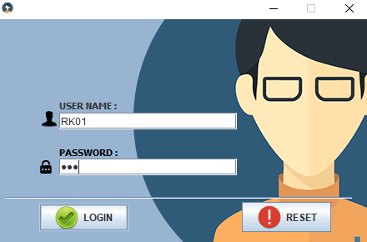
OFFICE LOGIN

Slide 15
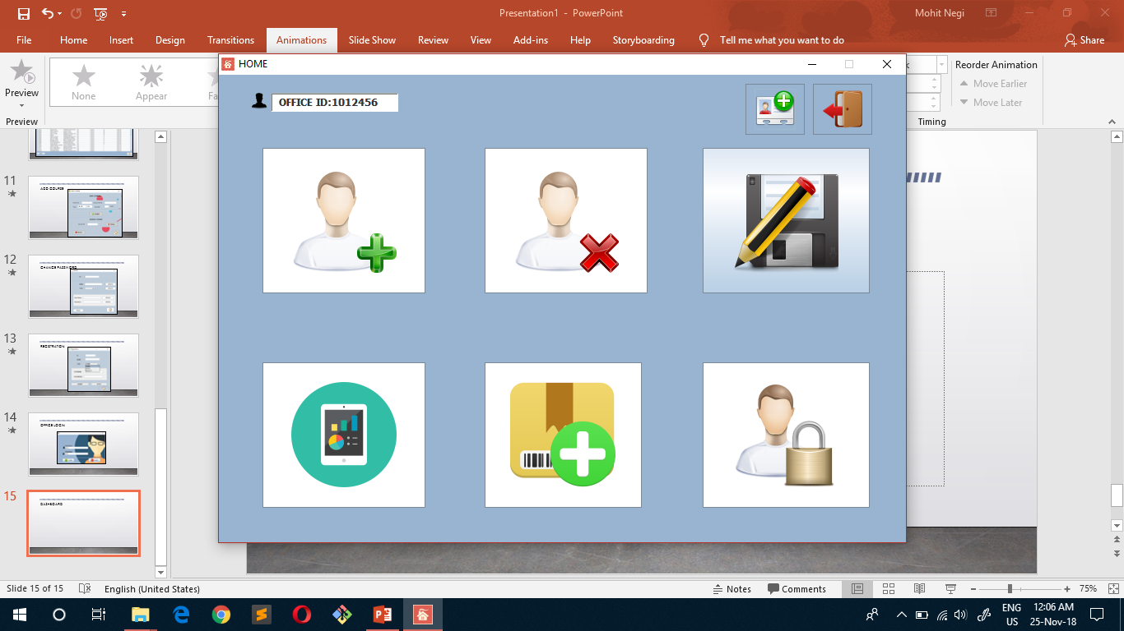
DASHBOARD

Slide 16
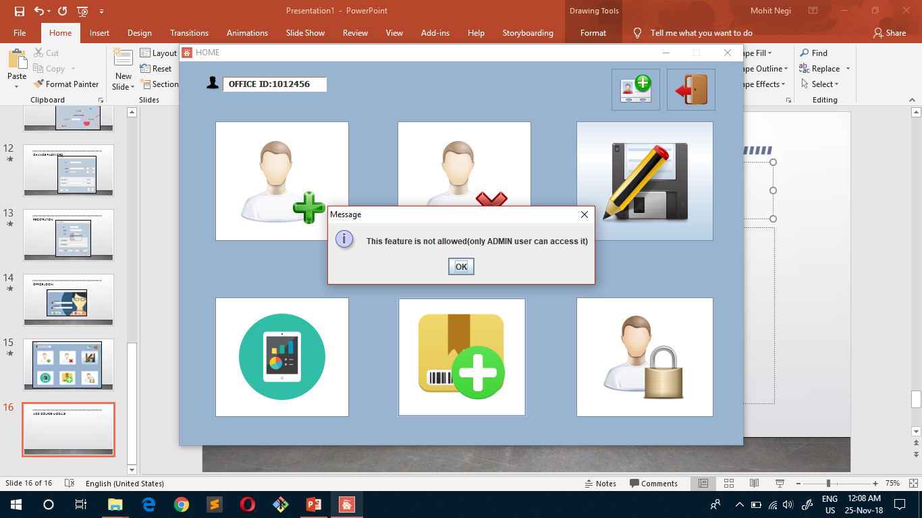
ADD COURSE MODULE

Slide 17
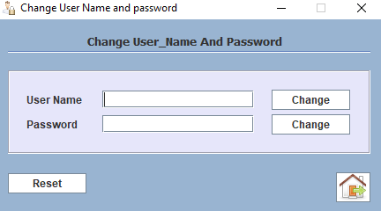
CHANGE PASSWORD

Slide 18
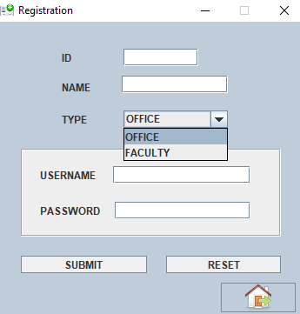
REGISTRATION

Slide 19
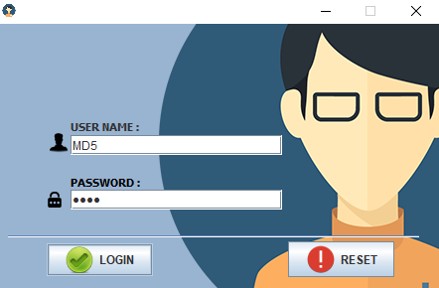
FACULTY LOGIN

Slide 20
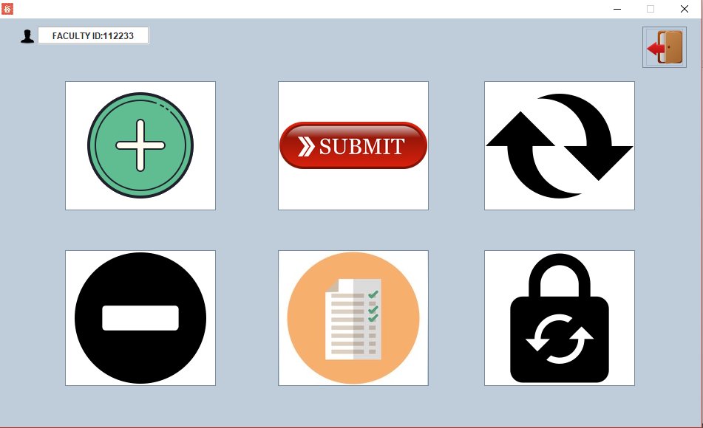
DASHBOARD

Slide 21
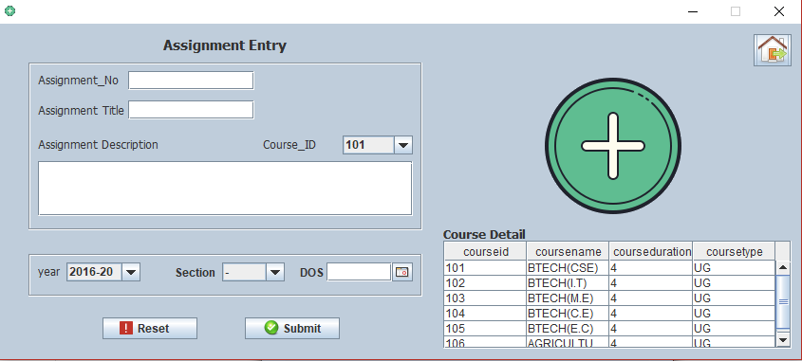
ADD ASSIGNMENT DETAILS

Slide 22
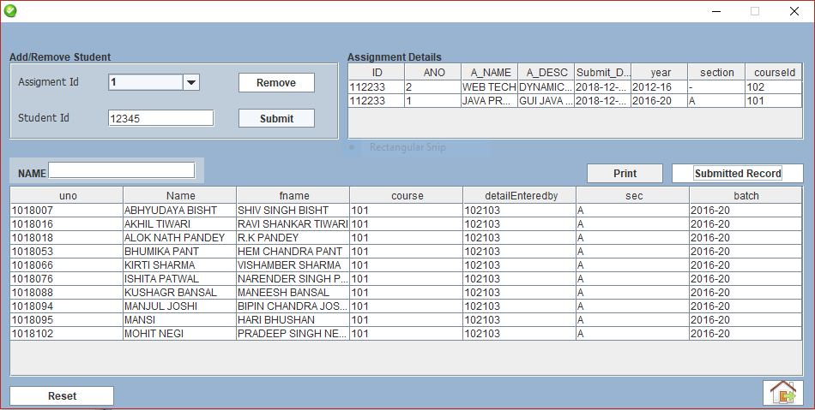
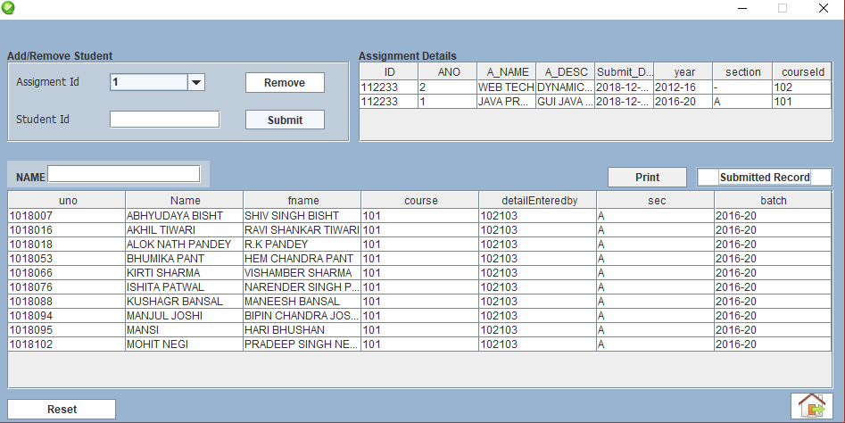
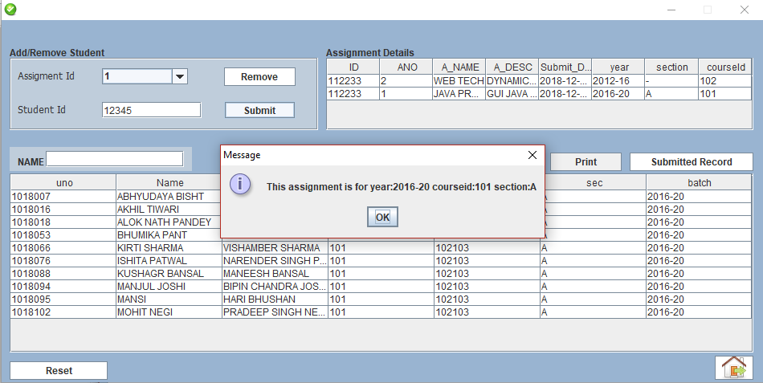
SUMBIT MODULE

Slide 23
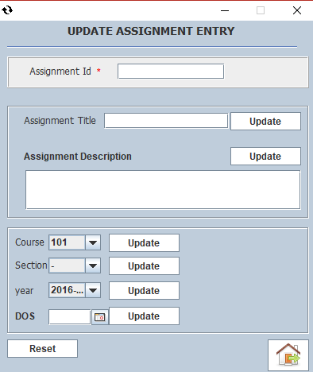
UPDATE RECORD

Slide 24
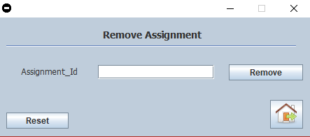
REMOVE ASSIGNMENT

Slide 25
THANK YOU FOR LISTENING

